Slide 1
Relational and NOSQL Databases
SQL Server – TSQL Queries Using the FleetFactors Database
Author: Adam Din
Course: Information Technology
B1035351@live.tees.ac.uk

Slide 2
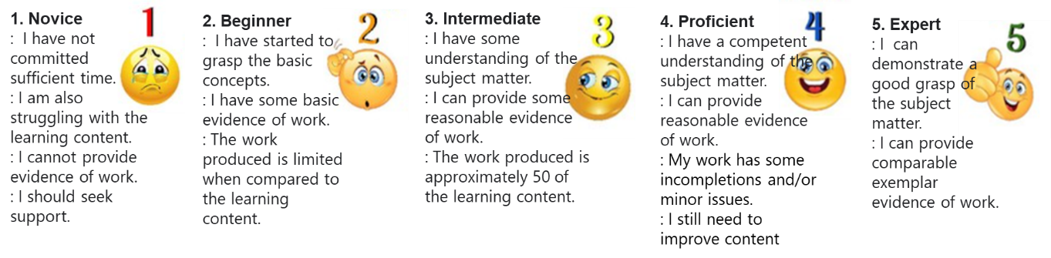
SQL Server Performance Rating
On the scale above I have given myself a rating of 4. This is because I do have a good understanding of SQL and its constructs queries, but need to improve my implementation of them.

Slide 3

SQL Practitioner Introduction
Why you decided upon studying and pursuing your interests in becoming a graduate developer?
I decided to study IT and pursue my interest in becoming a software developer/engineer because I want to further my skillset and knowledge in this area of IT, knowing how things are built and are structured.
Why should you learn SQL?
SQL is an essential programming language to learn/understand for a software engineer. SQL Server makes up the majority of the world’s databases, so knowledge and understanding of SQL is essential for a developer.

Slide 4
SQL Practitioner Introduction
Why you recommend someone should learn SQL and what you should hope to gain from it.
I recommend those who are interested in this area of IT to learn or develop an understanding of SQL as it is a big part of how things work, the skills of knowing SQL carry onto many different areas of IT and it is a worldwide industry standard.

Slide 5
Portfolio Structure
Information Technology
SQL Server
B1035351
Adam Din
The portfolio structure will follow:
TSQL module name with tasks given.
Screenshot of outputted query for evidence.
The code for the query will either be on the same slide or the next depending on screenshot size.
Repeat for each module.

Slide 6
SQL Server Database for Demos
I am going to investigate the SQL Server Database ‘FleetFactors’ to develop range of useful TSQL Queries and Scripts to support business functions or user requirements.
The aim is to provide useful patterns of data to serve front end development technologies such as Web or Mobile Applications.
Provided below in this document are examples of my TSQL Demos (Queries and Scripts) to support users of ‘FleetFactors’.

Slide 7
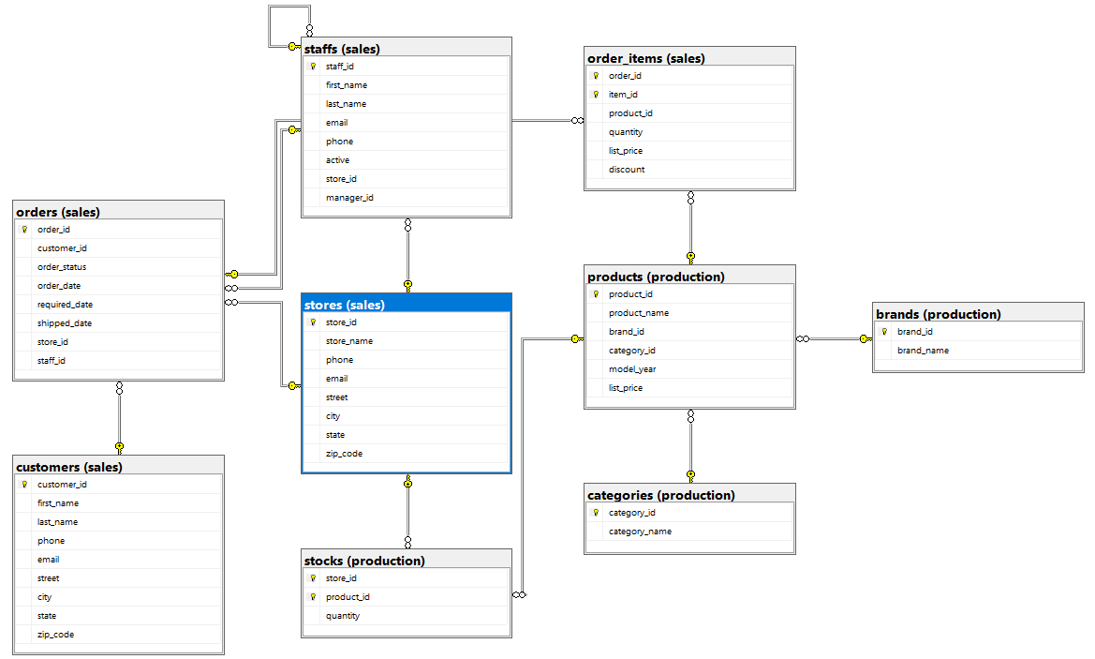
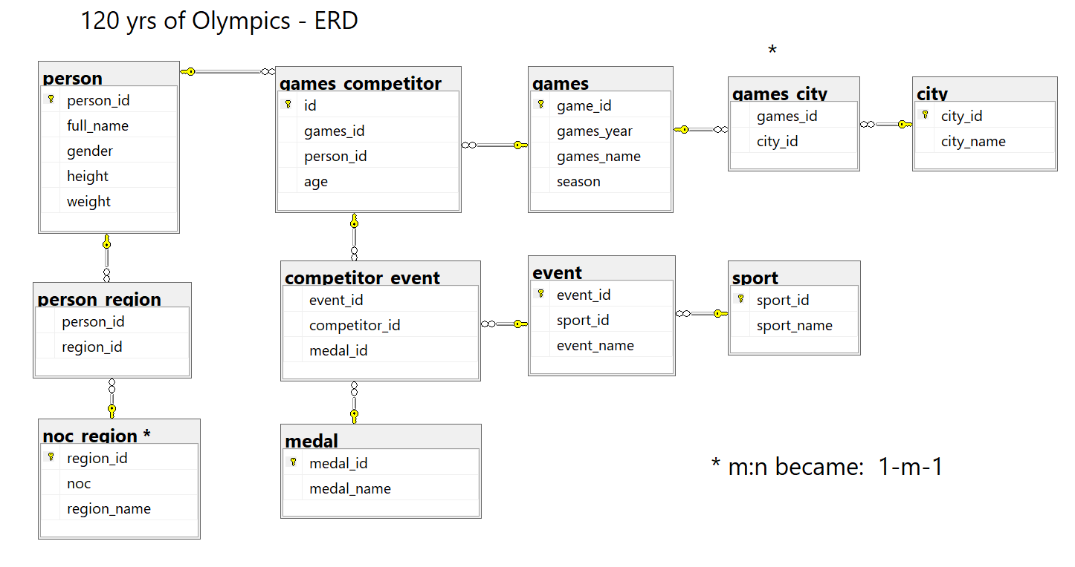
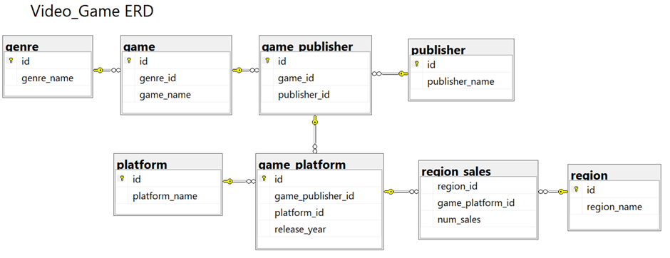
Entity Relationship Diagrams
Fleet Factor Database
The first few examples were used with different databases as I was practicing queries in these databases. I eventually moved onto Fleet Factor as my focus.
Olympics Database
Video Game Database

Slide 8
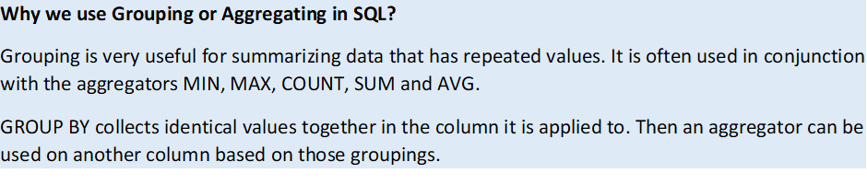
TSQL Module 1: Group and Aggregating Data
Using Aggregate Functions
Using the GROUP BY Clause
Filtering Groups with HAVING
Self Assessment Rating for this Module (1-5 | 5

Slide 9
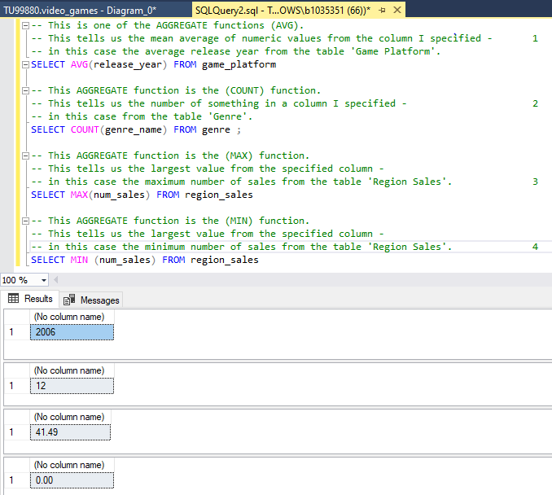
Using Aggregate Functions
TSQL Demo Code:
-- This is one of the AGGREGATE functions (AVG). -- This tells us the mean average of numeric values from the column I specified - 1 -- in this case the average release year from the table 'Game Platform'. SELECT AVG(release_year) FROM game_platform -- This AGGREGATE function is the (COUNT) function. -- This tells us the number of something in a column I specified - 2 -- in this case from the table 'Genre'. SELECT COUNT(genre_name) FROM genre ; -- This AGGREGATE function is the (MAX) function. -- This tells us the largest value from the specified column - -- in this case the maximum number of sales from the table 'Region Sales'. 3 SELECT MAX(num_sales) FROM region_sales -- This AGGREGATE function is the (MIN) function. -- This tells us the largest value from the specified column - -- in this case the minimum number of sales from the table 'Region Sales'. 4 SELECT MIN (num_sales) FROM region_sales

Slide 10
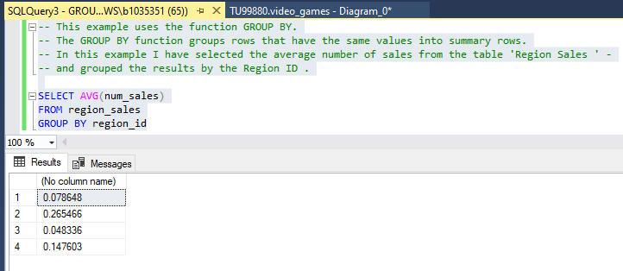
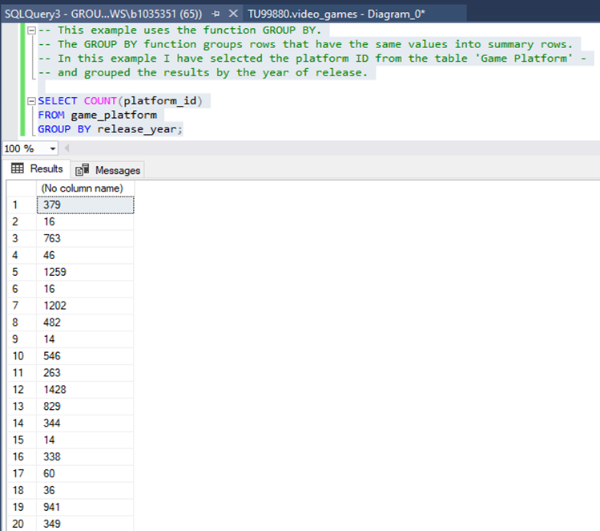
Using the GROUP BY Clause
TSQL Demo Code:
-- This example uses the function GROUP BY. -- The GROUP BY function groups rows that have the same values into summary rows. -- In this example I have selected the platform ID from the table 'Game Platform' - -- and grouped the results by the year of release. SELECT COUNT(platform_id) FROM game_platform GROUP BY release_year; -- This example uses the function GROUP BY. -- The GROUP BY function groups rows that have the same values into summary rows. -- In this example I have selected the average number of sales from the table 'Region Sales ' - -- and grouped the results by the Region ID. SELECT AVG(num_sales) FROM region_sales GROUP BY region_id

Slide 11
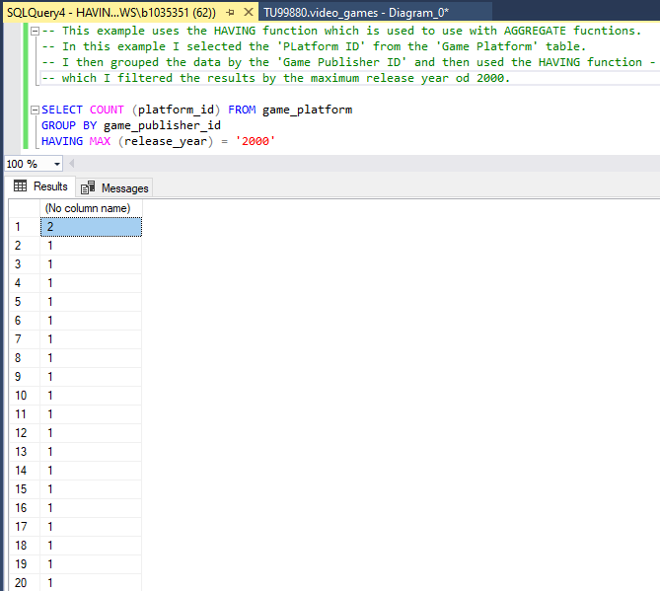
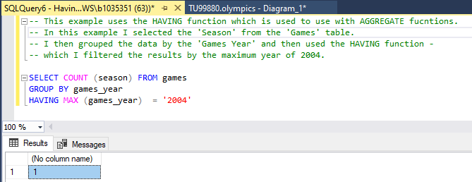
Filtering Groups with HAVING
TSQL Demo Code:
-- This example uses the HAVING function which is used to use with AGGREGATE fucntions. -- In this example I selected the 'PLatform ID' from the 'Game Platform' table. -- I then grouped the data by the 'Game Publisher ID' and then used the HAVING function - -- which I filtered the results by the maximum release year od 2000. SELECT COUNT (platform_id) FROM game_platform GROUP BY game_publisher_id HAVING MAX (release_year) = '2000' -- This example uses the HAVING function which is used to use with AGGREGATE fucntions. -- In this example I selected the 'Season' from the 'Games' table. -- I then grouped the data by the 'Games Year' and then used the HAVING function - -- which I filtered the results by the maximum year of 2004. SELECT COUNT (season) FROM games GROUP BY games_year HAVING MAX (games_year) = '2004'

Slide 12
TSQL Module 2: Using Subqueries
Writing Self-Contained Subqueries
Writing Correlated Subqueries
Using the EXISTS Predicate with Subqueries
Self Assessment Rating for this Module (1-5 | 5

Slide 13
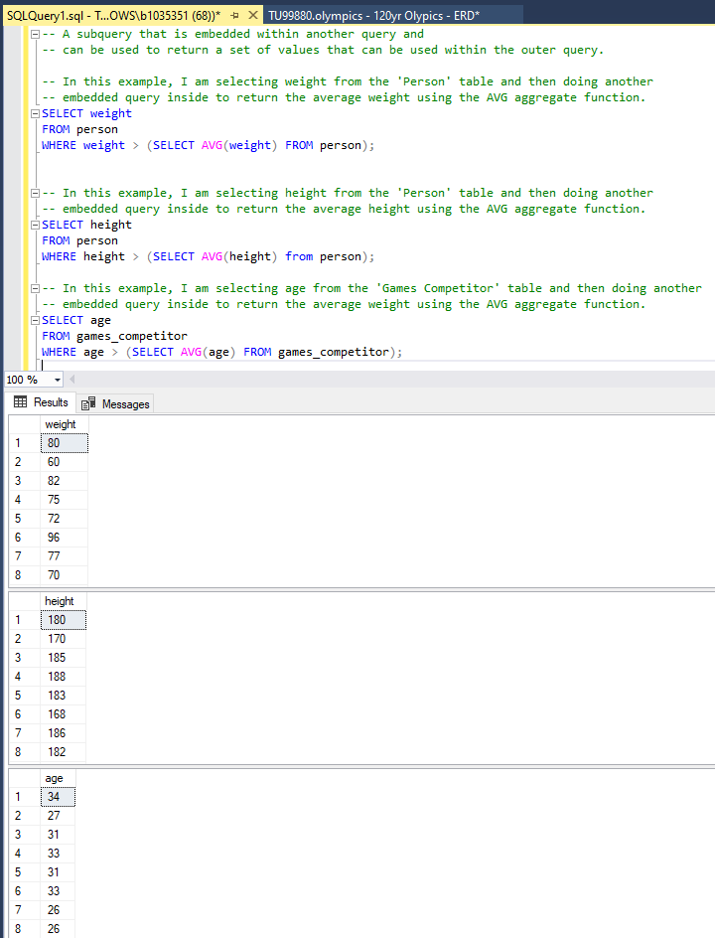
Writing Self-Contained Subqueries
TSQL Demo Code:
-- A subquery that is embedded within another query and -- can be used to return a set of values that can be used within the outer query. -- In this example, I am selecting weight from the 'Person' table and then doing another -- embedded query inside to return the average weight using the AVG aggregate function. SELECT weight FROM person WHERE weight > (SELECT AVG(weight) FROM person); -- In this example, I am selecting height from the 'Person' table and then doing another -- embedded query inside to return the average height using the AVG aggregate function. SELECT height FROM person WHERE height > (SELECT AVG(height) from person); -- In this example, I am selecting age from the 'Games Competitor' table and then doing another -- embedded query inside to return the average weight using the AVG aggregate function. SELECT age FROM games_competitor WHERE age > (SELECT AVG(age) FROM games_competitor);

Slide 14
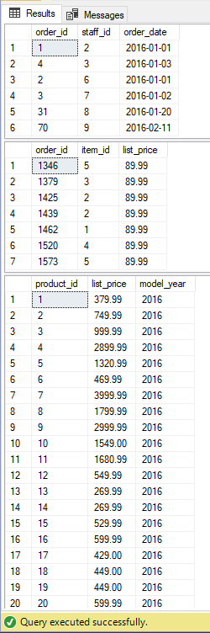
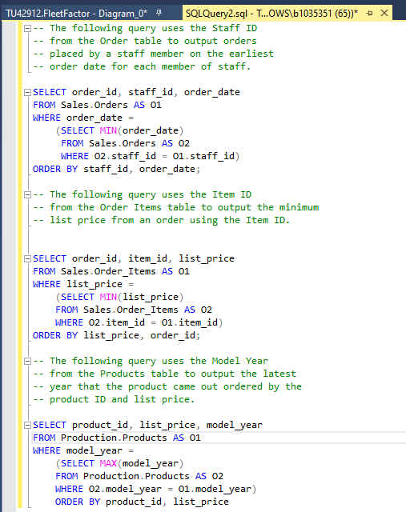
Writing Correlated Subqueries
TSQL Demo Code:
-- The following query uses the Staff ID -- from the Order table to output orders -- placed by a staff member on the earliest -- order date for each member of staff. SELECT order_id, staff_id, order_date FROM Sales.Orders AS O1 WHERE order_date = (SELECT MIN(order_date) FROM Sales.Orders AS O2 WHERE O2.staff_id = O1.staff_id) ORDER BY staff_id, order_date; -- The following query uses the Item ID -- from the Order Items table to output the minimum -- list price from an order using the Item ID. SELECT order_id, item_id, list_price FROM Sales.Order_Items AS O1 WHERE list_price = (SELECT MIN(list_price) FROM Sales.Order_Items AS O2 WHERE O2.item_id = O1.item_id) ORDER BY list_price, order_id; -- The following query uses the Model Year -- from the Products table to output the latest -- year that the product came out ordered by the -- product ID and list price. SELECT product_id, list_price, model_year FROM Production.Products AS O1 WHERE model_year = (SELECT MAX(model_year) FROM Production.Products AS O2 WHERE O2.model_year = O1.model_year) ORDER BY product_id, list_price

Slide 15
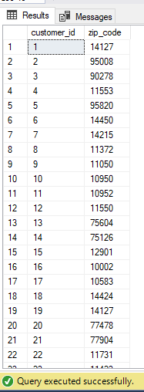
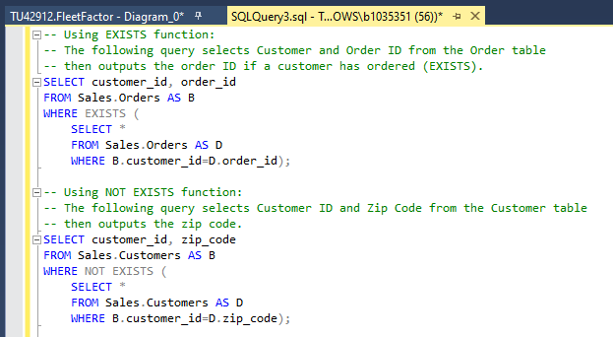
Using the EXISTS Predicate with Subqueries
TSQL Demo Code:
-- Using EXISTS function: -- The following query selects Customer and Order ID from the Order table -- then outputs the order ID if a customer has ordered (EXISTS). SELECT customer_id, order_id FROM Sales.Orders AS B WHERE EXISTS ( SELECT * FROM Sales.Orders AS D WHERE B.customer_id=D.order_id); -- Using NOT EXISTS function: -- The following query selects Customer ID and Zip Code from the Customer table -- then outputs the zip code. SELECT customer_id, zip_code FROM Sales.Customers AS B WHERE NOT EXISTS ( SELECT * FROM Sales.Customers AS D WHERE B.customer_id=D.zip_code);

Slide 16
TSQL Module 3: Using Table Expressions
Using Views
Using Inline TVF’s
Using Derived Tables
Using CTE’s
Self Assessment Rating for this Module (1-5 | 4

Slide 17
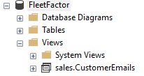
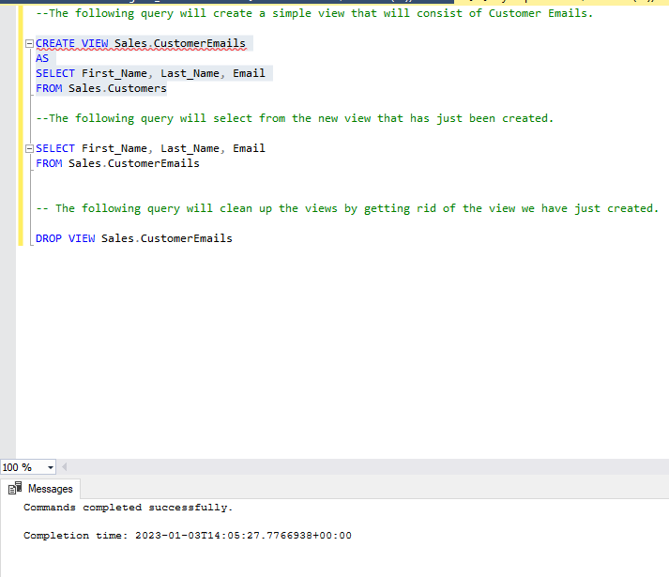
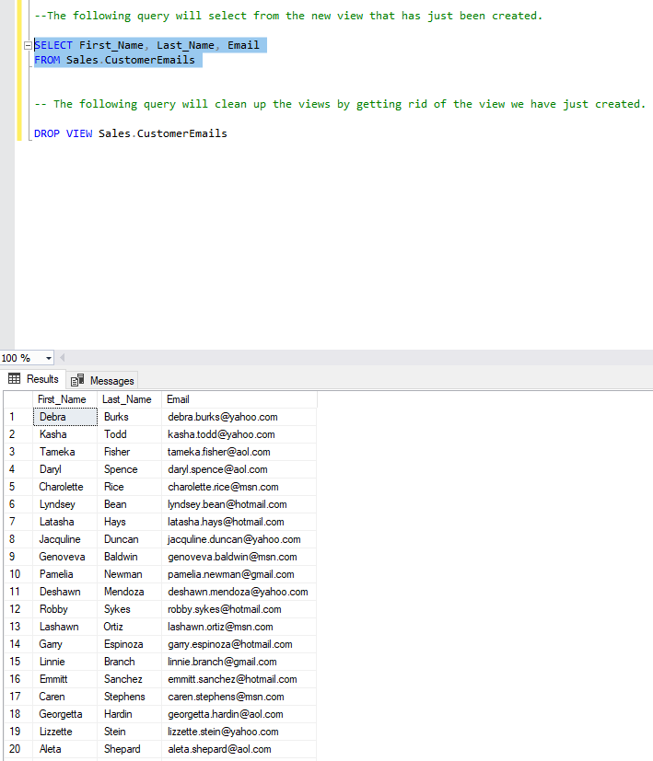
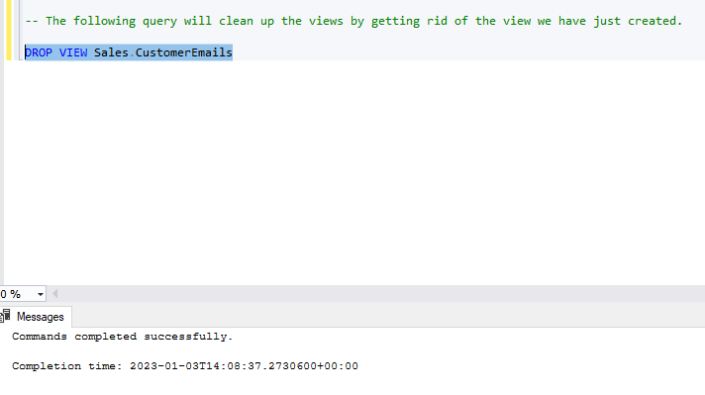
Using Views
TSQL Demo Code:
--The following query will create a simple view that will consist of Customer Emails. CREATE VIEW Sales.CustomerEmails AS SELECT First_Name, Last_Name, Email FROM Sales.Customers --The following query will select from the new view that has just been created. SELECT First_Name, Last_Name, Email FROM Sales.CustomerEmails -- The following query will clean up the views by getting rid of the view we have just created. DROP VIEW Sales.CustomerEmails

Slide 18
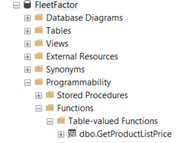
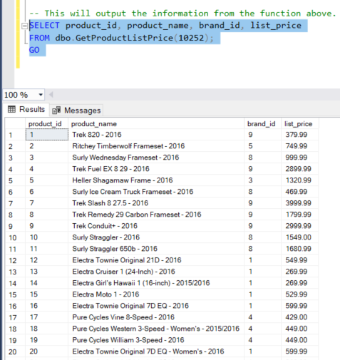
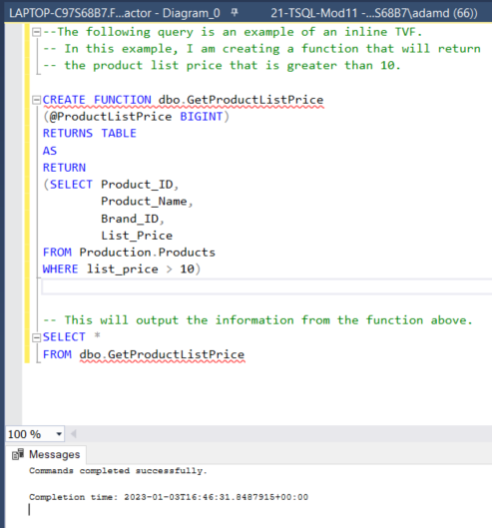
Using Inline TVF’s
TSQL Demo Code:
--The following query is an example of an inline TVF. -- In this example, I am creating a function that will return -- the product list price that is greater than 10. CREATE FUNCTION dbo.GetProductListPrice (@ProductListPrice BIGINT) RETURNS TABLE AS RETURN (SELECT Product_ID, Product_Name, Brand_ID, List_Price FROM Production.Products WHERE list_price > 10) -- This will output the information from the function above. SELECT product_id, product_name, brand_id, list_price FROM dbo.GetProductListPrice(10252); GO

Slide 19
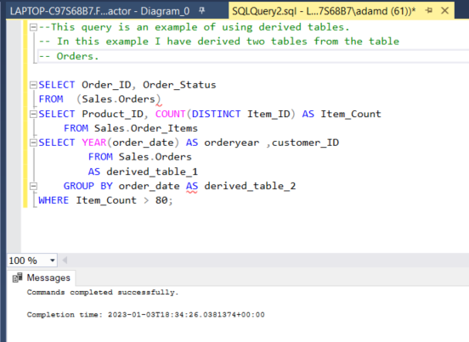
Using Derived Tables
TSQL Demo Code:
--This query is an example of using derived tables. -- In this example I have derived two tables from the table -- Orders. SELECT Order_ID, Order_Status FROM (Sales.Orders) SELECT Product_ID, COUNT(DISTINCT Item_ID) AS Item_Count FROM Sales.Order_Items SELECT YEAR(order_date) AS orderyear ,customer_ID FROM Sales.Orders AS derived_table_1 GROUP BY order_date AS derived_table_2 WHERE Item_Count > 80;
I didn’t really understand this task, I managed to successfully output something but couldn’t find the derived tables.

Slide 20
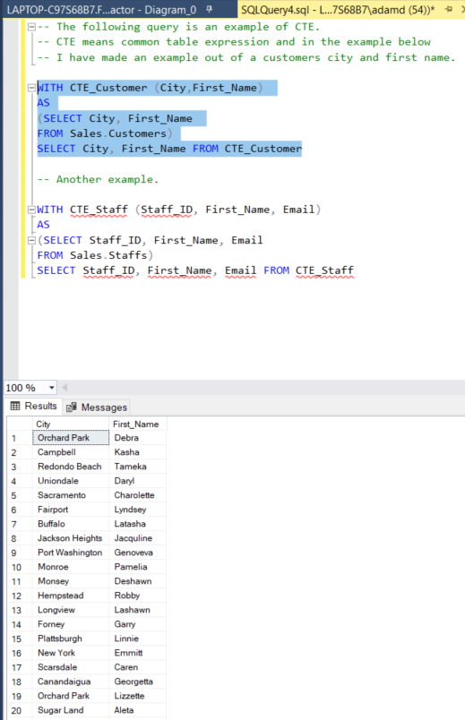
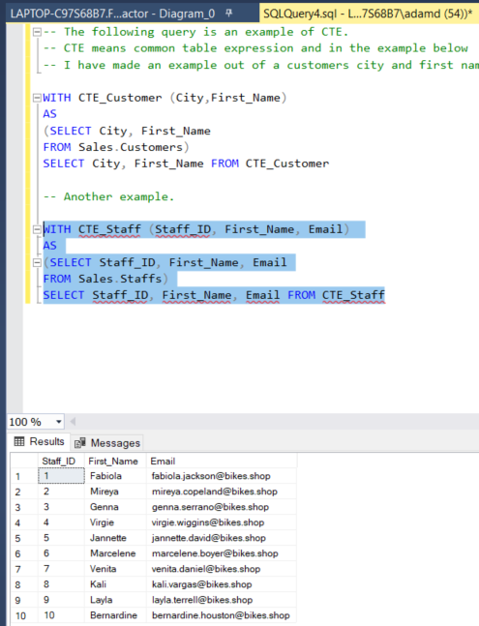
Using CTE’s
TSQL Demo Code:
-- The following query is an example of CTE. -- CTE means common table expression and in the example below -- I have made an example out of a customers city and first name. WITH CTE_Customer (City,First_Name) AS (SELECT City, First_Name FROM Sales.Customers) SELECT City, First_Name FROM CTE_Customer -- Another example. WITH CTE_Staff (Staff_ID, First_Name, Email) AS (SELECT Staff_ID, First_Name, Email FROM Sales.Staffs) SELECT Staff_ID, First_Name, Email FROM CTE_

Slide 21
TSQL Module 4: Using Set Operators
Self Assessment Rating for this Module (1-5 | 4
Writing Queries using Union + Intersect Except Set Operators

Slide 22
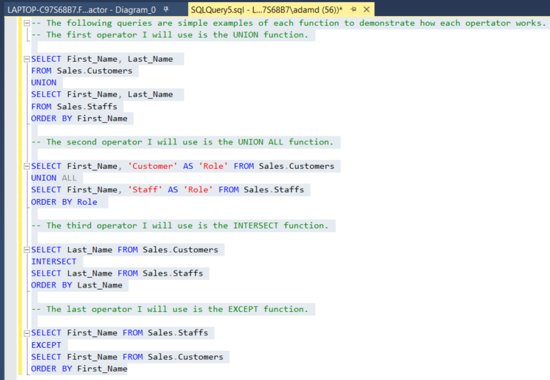
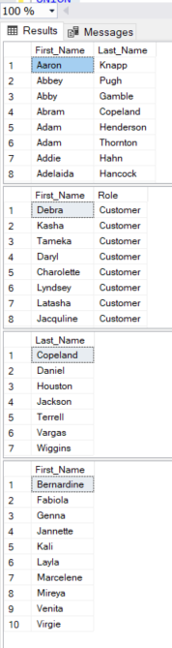
Writing Queries using Union Intersect Except Set Operators
TSQL Demo Code:
-- The following queries are simple examples of each function to demonstrate how each opertator works. -- The first operator I will use is the UNION function. SELECT First_Name, Last_Name FROM Sales.Customers UNION SELECT First_Name, Last_Name FROM Sales.Staffs ORDER BY First_Name -- The second operator I will use is the UNION ALL function. SELECT First_Name, 'Customer' AS 'Role' FROM Sales.Customers UNION ALL SELECT First_Name, 'Staff' AS 'Role' FROM Sales.Staffs ORDER BY Role -- The third operator I will use is the INTERSECT function. SELECT Last_Name FROM Sales.Customers INTERSECT SELECT Last_Name FROM Sales.Staffs ORDER BY Last_Name -- The last operator I will use is the EXCEPT function. SELECT First_Name FROM Sales.Staffs EXCEPT SELECT First_Name FROM Sales.Customers ORDER BY First_Name

Slide 23
TSQL Module 5: Using Window Ranking, Offset, and Aggregate Functions
Self Assessment Rating for this Module (1-5 | 4
Partition by Row Number Function
Windows Ranking
OVER Clause
Writing Aggregate Function in Partition By
For this module I have combined the tasks together into the same queries. (Over Clause + Aggregate Functions with Partition By).

Slide 24
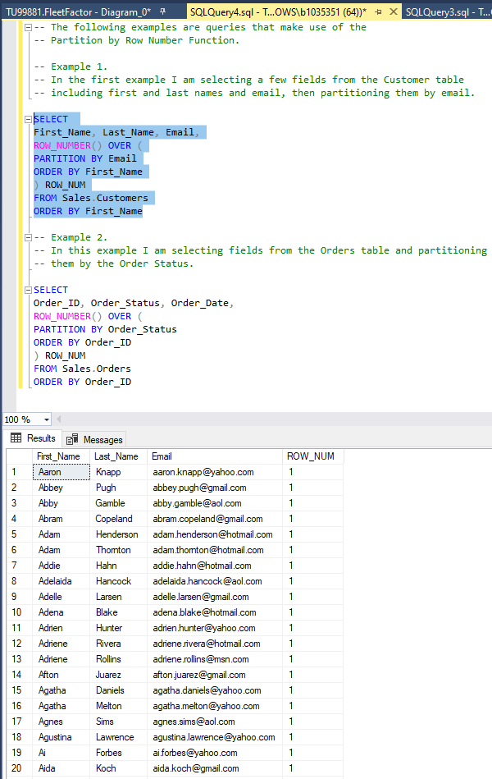
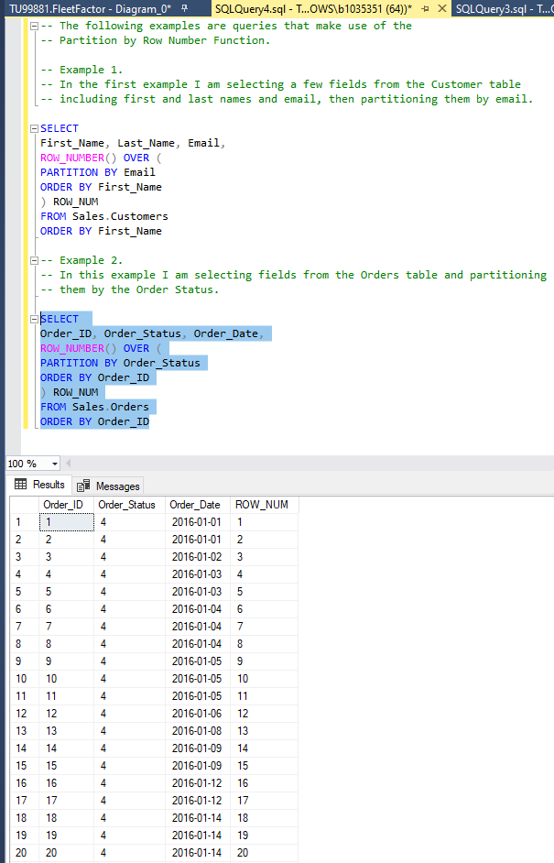
Partition by Row Number Function
TSQL Demo Code:
-- The following examples are queries that make use of the -- Partition by Row Number Function. -- Example 1. -- In the first example I am selecting a few fields from the Customer table -- including first and last names and email, then partitioning them by email. SELECT First_Name, Last_Name, Email, ROW_NUMBER() OVER ( PARTITION BY Email ORDER BY First_Name ) ROW_NUM FROM Sales.Customers ORDER BY First_Name -- Example 2. -- In this example I am selecting fields from the Orders table and partitioning -- them by the Order Status. SELECT Order_ID, Order_Status, Order_Date, ROW_NUMBER() OVER ( PARTITION BY Order_Status ORDER BY Order_ID ) ROW_NUM FROM Sales.Orders ORDER BY Order_ID

Slide 25
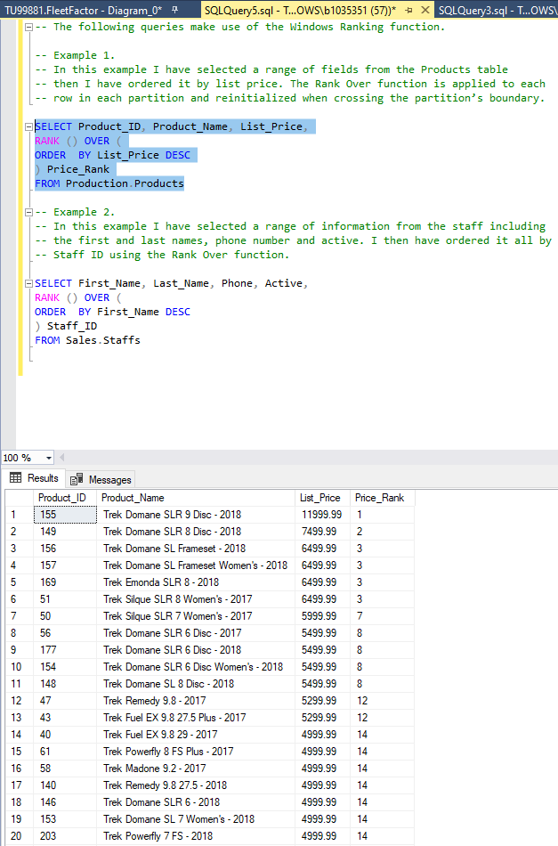
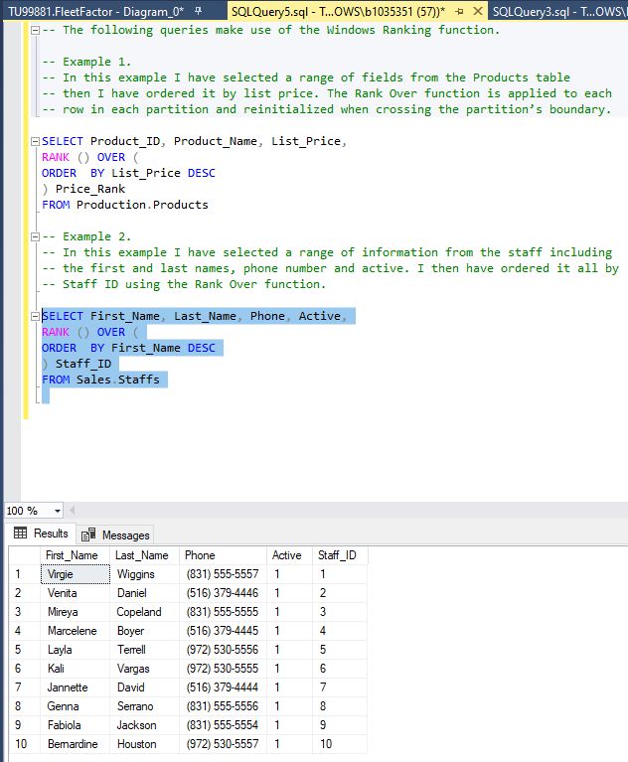
Windows Ranking
TSQL Demo Code:
-- The following queries make use of the Windows Ranking function. -- Example 1. -- In this example I have selected a range of fields from the Products table -- then I have ordered it by list price. The Rank Over function is applied to each -- row in each partition and reinitialized when crossing the partition’s boundary. SELECT Product_ID, Product_Name, List_Price, RANK () OVER ( ORDER BY List_Price DESC ) Price_Rank FROM Production.Products -- Example 2. -- In this example I have selected a range of information from the staff including -- the first and last names, phone number and active. I then have ordered it all by -- Staff ID using the Rank Over function. SELECT First_Name, Last_Name, Phone, Active, RANK () OVER ( ORDER BY First_Name DESC ) Staff_ID FROM Sales.Staffs

Slide 26
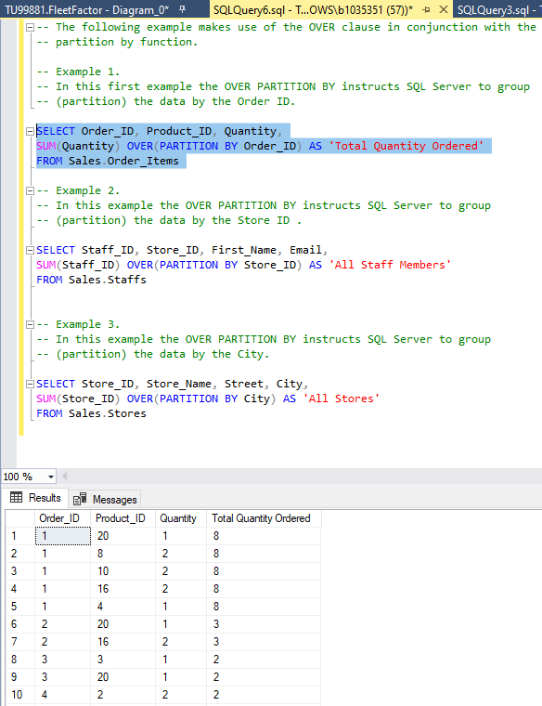
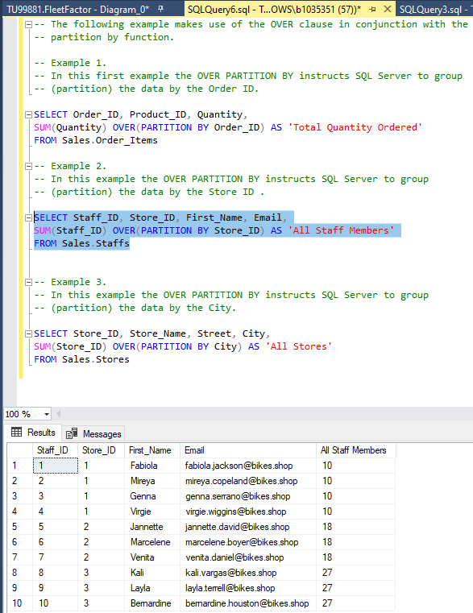
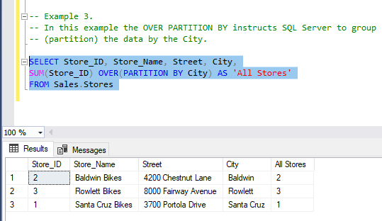
OVER Clause + Aggregate Functions with Partition By
TSQL Demo Code:
-- The following example makes use of the OVER clause in conjunction with the -- partition by function. -- Example 1. -- In this first example the OVER PARTITION BY instructs SQL Server to group -- (partition) the data by the Order ID. SELECT Order_ID, Product_ID, Quantity, SUM(Quantity) OVER(PARTITION BY Order_ID) AS 'Total Quantity Ordered' FROM Sales.Order_Items -- Example 2. -- In this example the OVER PARTITION BY instructs SQL Server to group -- (partition) the data by the Store ID . SELECT Staff_ID, Store_ID, First_Name, Email, SUM(Staff_ID) OVER(PARTITION BY Store_ID) AS 'All Staff Members' FROM Sales.Staffs -- Example 3. -- In this example the OVER PARTITION BY instructs SQL Server to group -- (partition) the data by the City. SELECT Store_ID, Store_Name, Street, City, SUM(Store_ID) OVER(PARTITION BY City) AS 'All Stores' FROM Sales.Stores

Slide 27
TSQL Module 6: Pivoting and Grouping Sets
Working with Grouping Sets
Writing Queries with PIVOT and UNPIVOT
For this module I understood the theory behind the functions however I didn’t manage to implement a successful solution which is what I will work on.
Self Assessment Rating for this Module (1-5 | 2 I understood the knowledge behind each function but didn’t manage to successfully implement a solution.

Slide 28
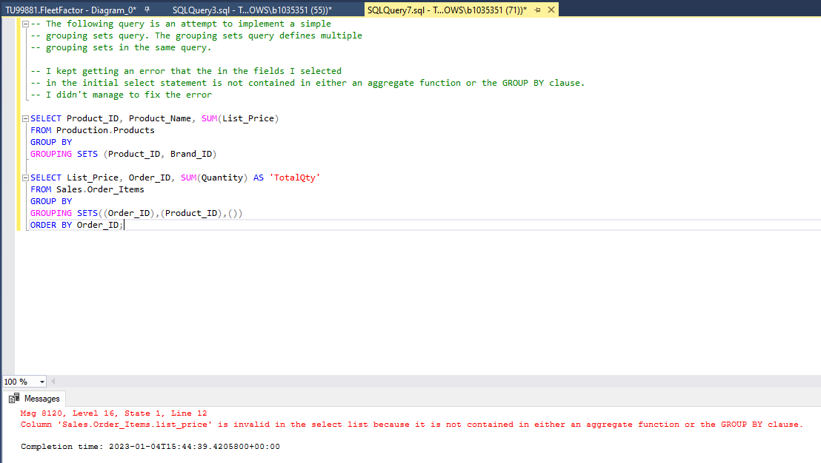
Working with Grouping Sets
TSQL Demo Code:
-- The following query is an attempt to implement a simple -- grouping sets query. The grouping sets query defines multiple -- grouping sets in the same query. -- I kept getting an error that the in the fields I selected -- in the initial select statement is not contained in either an aggregate function or the GROUP BY clause. -- I didn't manage to fix the error SELECT Product_ID, Product_Name, SUM(List_Price) FROM Production.Products GROUP BY GROUPING SETS (Product_ID, Brand_ID) SELECT List_Price, Order_ID, SUM(Quantity) AS 'TotalQty' FROM Sales.Order_Items GROUP BY GROUPING SETS((Order_ID),(Product_ID),()) ORDER BY Order_ID;
This construct will be one of the tasks I will try and understand better so I can implement a solution in future.

Slide 29
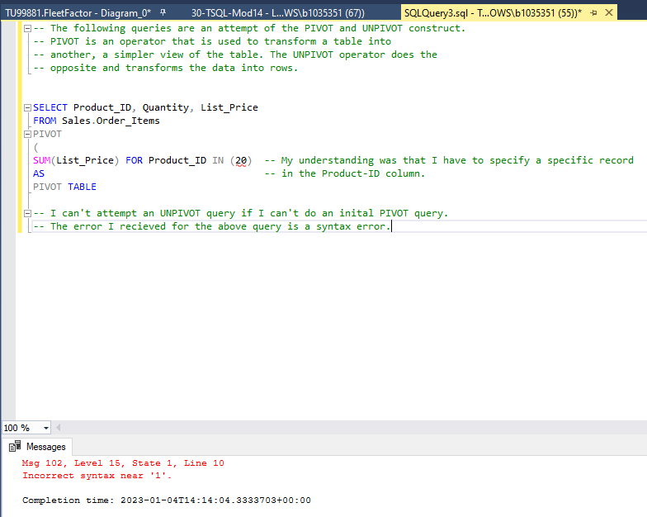
Writing Queries with PIVOT and UNPIVOT
TSQL Demo Code:
-- The following queries are an attempt of the PIVOT and UNPIVOT construct. -- PIVOT is an operator that is used to transform a table into -- another, a simpler view of the table. The UNPIVOT operator does the -- opposite and transforms the data into rows. SELECT Product_ID, Quantity, List_Price FROM Sales.Order_Items PIVOT ( SUM(List_Price) FOR Product_ID IN (20) -- My understanding was that I have to specify a specific record AS -- in the Product-ID column. PIVOT TABLE -- I can't attempt an UNPIVOT query if I can't do an inital PIVOT query. -- The error I recieved for the above query is a syntax error.
This construct will be one of the tasks I will try and understand better so I can implement a solution in future.

Slide 30
TSQL Module 7: Executing Stored Procedures
TSQL Stored Procedures
TSQL Stored Procedures with Parameters
Passing Parameters to Stored Procedures
Self Assessment Rating for this Module (1-5 | 5

Slide 31
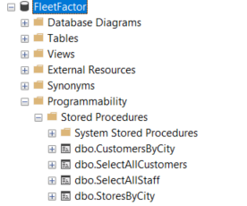
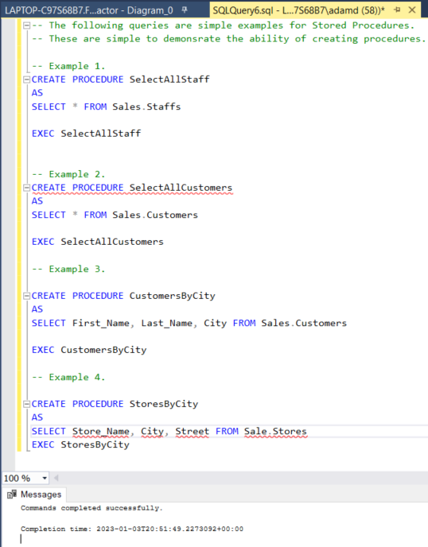
TSQL Stored Procedures
TSQL Demo Code:
-- The following queries are simple examples for Stored Procedures. -- These are simple to demonsrate the ability of creating procedures. -- Example 1. CREATE PROCEDURE SelectAllStaff AS SELECT * FROM Sales.Staffs EXEC SelectAllStaff -- Example 2. CREATE PROCEDURE SelectAllCustomers AS SELECT * FROM Sales.Customers EXEC SelectAllCustomers -- Example 3. CREATE PROCEDURE CustomersByCity AS SELECT First_Name, Last_Name, City FROM Sales.Customers EXEC CustomersByCity -- Example 4. CREATE PROCEDURE StoresByCity AS SELECT Store_Name, City, Street FROM Sale.Stores EXEC StoresByCity

Slide 32
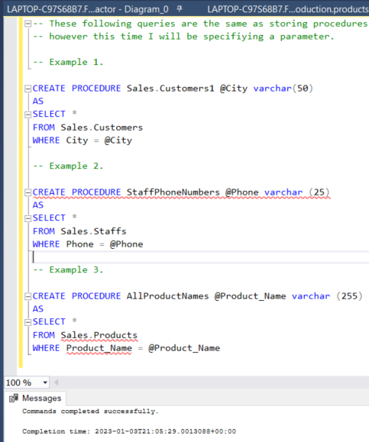
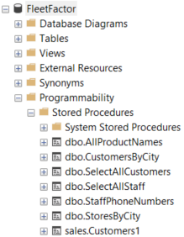
TSQL Stored Procedures with Parameters
TSQL Demo Code:
-- These following queries are the same as storing procedures -- however this time I will be specifiying a parameter. -- Example 1. CREATE PROCEDURE Sales.Customers1 @City varchar(50) AS SELECT * FROM Sales.Customers WHERE City = @City -- Example 2. CREATE PROCEDURE StaffPhoneNumbers @Phone varchar (25) AS SELECT * FROM Sales.Staffs WHERE Phone = @Phone -- Example 3. CREATE PROCEDURE AllProductNames @Product_Name varchar (255) AS SELECT * FROM Sales.Products WHERE Product_Name = @Product_Name

Slide 33
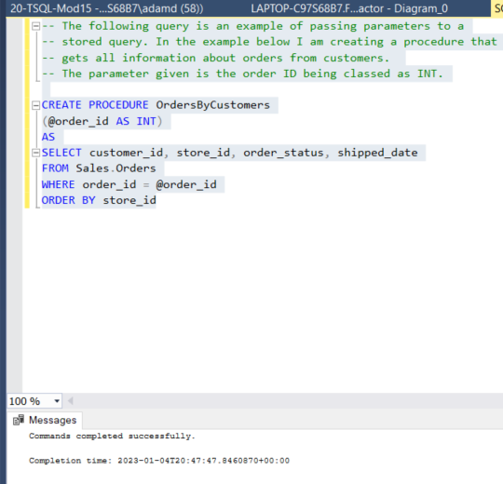
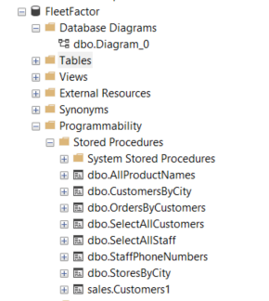
Passing Parameters to Stored Procedures
TSQL Demo Code:
-- The following query is an example of passing parameters to a -- stored query. In the example below I am creating a procedure that -- gets all information about orders from customers. -- The parameter given is the order ID being classed as INT. CREATE PROCEDURE OrdersByCustomers (@order_id AS INT) AS SELECT customer_id, store_id, order_status, shipped_date FROM Sales.Orders WHERE order_id = @order_id ORDER BY store_id

Slide 34
TSQL Module 8: Implementing Error Handling
Implementing TSQL Error Handling
Implementing Structured Exception Handling
Self Assessment Rating for this Module (1-5 | 4
For this module I have combined the tasks together into the same queries.

Slide 35
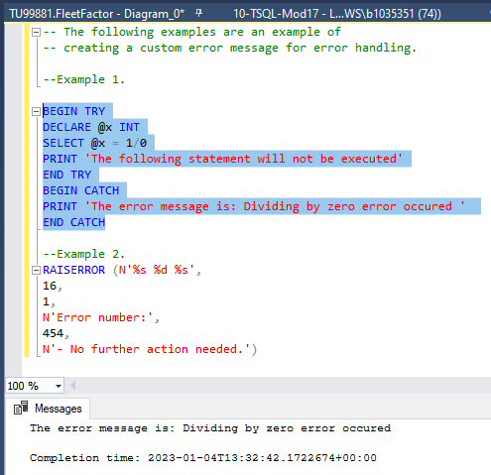
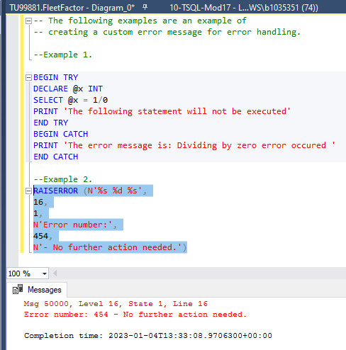
Implementing TSQL Error Handling + Structured Handling
TSQL Demo Code:
-- The following examples are an example of -- creating a custom error message for error handling. --Example 1. (Structured Handling). The TRY/CATCH construct is the structured mechanism for error handling. It consists of two parts; TRY block and CATCH block. The error in this message comes from the arithmetic error of 1/0. BEGIN TRY DECLARE @x INT SELECT @x = 1/0 PRINT 'The following statement will not be executed' END TRY BEGIN CATCH PRINT 'The error message is: Dividing by zero error occured ' END CATCH --Example 2.This is a simple error handling generated by the user. The user just needs to input am error number and message and use the RAISEERROR construct. RAISERROR (N'%s %d %s', 16, 1, N'Error number:', 454, N'- No further action needed.')

